Slide 1

Cryptocurrency Analysis
Brett Sutow
DSC 680

Slide 2
Overview
Background on Cryptocurrency
History of cryptocurrency
Cryptocurrency market conditions
Predictive Analytics of Cryptocurrency
Can cryptocurrency be predicted
Ability to gain an investment advantage
Investing
Can we improve investing
Should we invest in cryptocurrency

Slide 3
Investment Types
Stocks
Bonds
Cryptocurrency

Slide 4
Background on Cryptocurrency
Unregulated digital currency
Utilizes blockchain to keep ledger of exchanges
Asset can be freely traded, bought, or sold
Utilized for purchasing different things
Well-known on the black market

Slide 5
Types of Cryptocurrency
Bitcoin
Most well-known cryptocurrency
Started in 2009
Rapidly growing
Ethereum
Newer and growing cryptocurrency
Started in 2015
Become more popular in recent years
Dogecoin
Recently extremely popular in the market
Started in 2013
Part of the meme craze

Slide 6
Bitcoin Price Changes

Slide 7
Ethereum Price Changes

Slide 8
Dogecoin Price Changes

Slide 9
Cryptocurrency Market Conditions
High volatility in the market
Freely traded 24/7
Easily manipulated
Unregulated dangers
Regulation potential

Slide 10
Predictive Analytics
Utilization of machine learning and LSTM model
Predict future prices of cryptocurrency based off current pricing
Looks 60 days into the future to see if model can predict prices
Are the cryptocurrencies predictable

Slide 11
Bitcoin Model

Slide 12
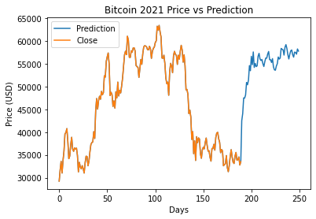
Bitcoin Model

Slide 13
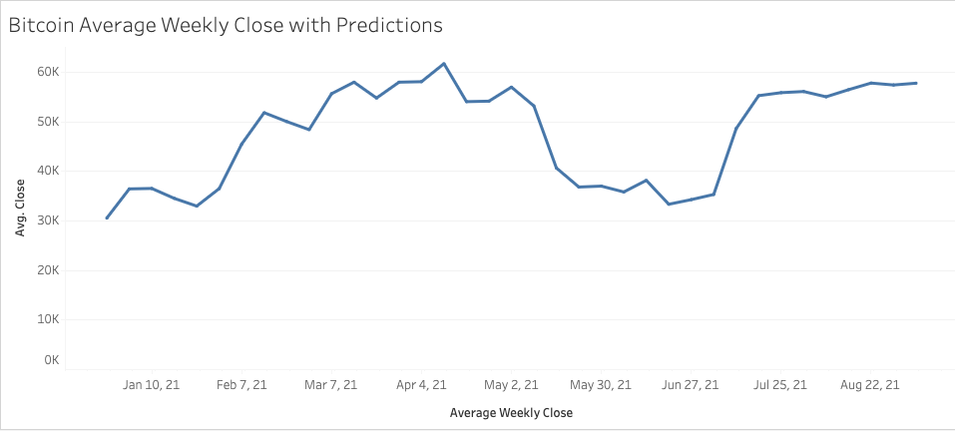
Bitcoin Model

Slide 14
Ethereum Model

Slide 15
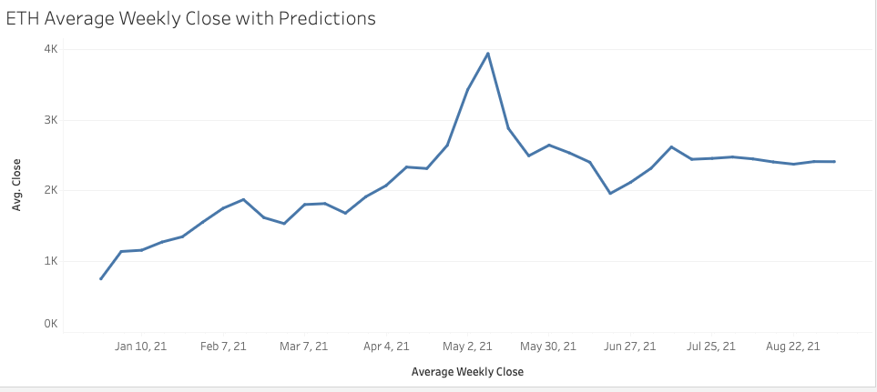
Ethereum Model

Slide 16
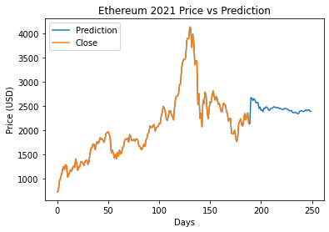
Ethereum Model

Slide 17
Dogecoin Model

Slide 18
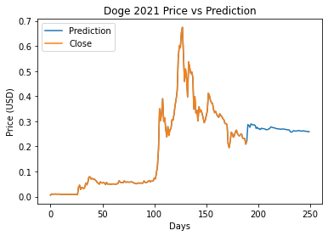
Dogecoin Model

Slide 19
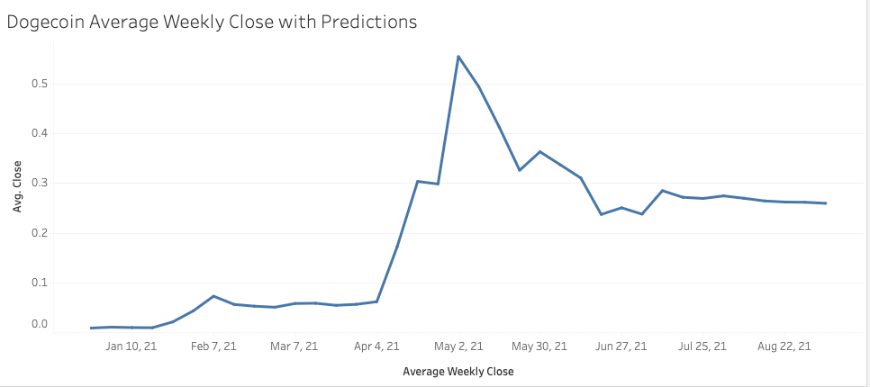
Dogecoin Model

Slide 20
Investing Results
The predictive model is an asset
It should be used as a resource
Cryptocurrency is volatile

Slide 21
Future of Cryptocurrency
Cryptocurrency is extremely volatile
Predictive analytics has difficulty picking up the trends
It is too easily manipulated
Regulation to come and ruin it

Slide 22
Questions
These questions were from a pre-determined panel:
What is the best crypto to invest in?
Where do you see crypto going?
Can we better improve the predictive model?
What stands in the way of accurate predicting?
How does this differ from stocks?
Do you consider crypto to be a safe investment?
What is the future of the crypto investments?
Historically, how has crypto preformed?
Why is there so much volatility?
Does the prices reflect actual value?

Slide 23
References
Bambrough, B. (2021, July 8). Crypto Price Warning: Goldman Sachs Issues Surprise Future Of Bitcoin And Ethereum Prediction. Forbes. https://www.forbes.com/sites/billybambrough/2021/07/08/crypto-price-warning-goldman-sachs-issues-surprise-future-of-bitcoin-and-ethereum-prediction/?sh=39dd300942ea
Business Desk. (2021, July 8). Bitcoin to Fall, Ether to Rise: What Analysts Say About Crypto Future. News18. https://www.news18.com/news/business/bitcoin-to-fall-ether-to-rise-what-analysts-say-about-crypto-future-3941006.html
Chen, J. (2020a, November 27). Blue-Chip Stock Definition. Investopedia. https://www.investopedia.com/terms/b/bluechipstock.asp
Chen, J. (2020b, December 31). 2020 Was a Big Year for Individual Investors. Investopedia. https://www.investopedia.com/2020-was-a-big-year-for-individual-investors-5094063
Davies. (n.d.). A short history of cryptocurrencies. Retrieved July 14, 2021, from https://daviescoin.io/blog/a-short-history-of-cryptocurrencies.html#:%7E:text=In%201983%2C%20the%20American%20developed,was%20coined%20was%20in%201998.
Dogecoin Price Prediction Using Python & Machine Learning. (2021, April 20). YouTube. https://www.youtube.com/watch?v=FMKnvsKoQxE
Ethereum (ETH) Price Prediction using Machine Learning (SVR) & Python. (2021, July 8). YouTube. https://www.youtube.com/watch?v=HiDEAWdAif0
Fortune Business Insights. (2021, May 12). Cryptocurrency Market to Hit USD 1758.0 Million by 2027; Growing Acceptance of Cryptocurrency in Various Nations to Foster Market Growth: Says Fortune Business Insights<sup>TM</i>. GlobeNewswire News Room. https://www.globenewswire.com/news-release/2021/05/12/2228140/0/en/Cryptocurrency-Market-to-Hit-USD-1758-0-Million-by-2027-Growing-Acceptance-of-Cryptocurrency-in-Various-Nations-to-Foster-Market-Growth-Says-Fortune-Business-Insights.html
Karen, T. (2021, March 30). Predicting Bitcoin’s Price With Recurrent Neural Networks. Medium. https://levelup.gitconnected.com/predicting-bitcoins-price-with-recurrent-neural-networks-a27b4d2d839
Kurt, G. (2020, March 18). Predicting Bitcoin Prices With LSTM - Analytics Vidhya. Medium. https://medium.com/analytics-vidhya/predicting-bitcoin-prices-with-lstm-19e578d389c4
Lucia, A. (2021, May 25). Bitcoin Price Prediction Using Recurrent Neural Networks and LSTM. Analytics Vidhya. https://www.analyticsvidhya.com/blog/2021/05/bitcoin-price-prediction-using-recurrent-neural-networks-and-lstm/
Nasdaq. (n.d.). Daily Stock Market Overview, Data Updates, Reports & News. https://www.nasdaq.com/
Predict The Future Price of Ethereum Using Python & Machine Learning. (2021, May 15). YouTube. https://www.youtube.com/watch?v=OcpAkACOwW0
Rearick, B. (2021, April 14). Mark Cuban, Guy Fieri, Elon Musk and 6 Other Celebrities Helping Dogecoin Prices Rocket. InvestorPlace. https://investorplace.com/2021/04/mark-cuban-guy-fieri-elon-musk-and-6-other-celebrities-helping-dogecoin-prices-rocket/
Rosenberg, E. (2021, March 30). History of Cryptocurrency. The Balance. https://www.thebalance.com/history-of-cryptocurrency-5119511
Yıldırım, S. (2020, April 15). Cryptocurrency Prediction with LSTM - Towards Data Science. Medium. https://towardsdatascience.com/cryptocurrency-prediction-with-lstm-4cc369c43d1b

Slide 24
Thank You!

